Slide 1
Operating Systems
Chapter 6b
Process Synchronization
Hammad Afzal
hammad.afzal@mcs.edu.pk
Department of Computer Software Engineering
National University of Sciences and Technology

Slide 2
Process Synchronization
Synchronization Hardware
Semaphores

Slide 3
Synchronization Hardware
Any solution to critical section problem requires a lock.
Race conditions are prevented by requiring that critical section be protected by locks.
Design of such locks can be sophisticated.
Many systems provide hardware support for critical section code
do {
acquire lock
critical section
release lock
remainder section
} while (TRUE);

Slide 4
Synchronization Hardware
Uni-Processors – could disable interrupts while a shared variable being modified.
Currently running code would execute without preemption.
Approach taken by non-preemptive kernels.
Generally too inefficient on multiprocessor systems
Too much time consumed as message is passed to all processors.
Message passing delays entry into critical section

Slide 5
Disabling Interrupts: Pseudocode
while (true) {
/* disable interrupts */;
/* critical section */;
/* enable interrupts */;
/* remainder */;
}
Notes:
In a uniprocessor system, concurrent processes cannot have overlapped execution;
they can only be interleaved.
To guarantee mutual exclusion, it is sufficient to prevent a process from being interrupted.

Slide 6
Synchronization Hardware
Modern machines provide special atomic hardware instructions
Test & Set Instruction
Either test and modify content of word
Exchange Instruction
Or swap contents of two memory words atomically.
Atomic = non-interruptable

Slide 7
Solution using TestAndSet
Definition of TestAndSet:
boolean TestAndSet (boolean *target)
{
boolean rv = *target;
*target = TRUE;
return rv:
}
Process using Test&Set;
Shared boolean variable lock, initialized to FALSE
do {
while ( TestAndSet (&lock ))
; // do nothing
// critical section
lock = FALSE;
// remainder section
} while (TRUE);

Slide 8
Solution using SWAP
Definition of SWAP:
void Swap (boolean *a, boolean *b) {
boolean temp = *a;
*a = *b;
*b = temp:
}
Process using SWAP;
Shared Boolean variable lock initialized to FALSE;
Each process has a local Boolean variable key
do {
key = TRUE;
while ( key == TRUE)
Swap (&lock, &key );
// critical section
lock = FALSE;
// remainder section
} while (TRUE);

Slide 9
Hardware Mutual Exclusion: Advantages
Applicable to any number of processes on either a single processor or multiple processors sharing main memory
It is simple and therefore easy to verify
It can be used to support multiple critical sections

Slide 10
Hardware Mutual Exclusion: Disadvantages
Busy-waiting consumes processor time
Starvation is possible when a process leaves a critical section and more than one process is waiting.
Deadlock is possible
Notes:
Busy waiting
While a process is waiting for access to a critical section, it continues to consume processor time.
Starvation is possible.
When a process leaves a critical section and more than one process is waiting, the selection of a waiting process is arbitrary.
Thus, some process could indefinitely be denied access.
Deadlock is possible.
Example (on a uniprocessor).
Process P1 executes the special instruction (e.g., compare&swap, exchange) and enters its critical section.
P1 is then interrupted to give the processor to P2, which has higher priority.
If P2 now attempts to use the same resource as P1, it will be denied access because of the mutual exclusion mechanism.
Thus it will go into a busy waiting loop.
However, P1 will never be dispatched because it is of lower priority than another ready process, P2.

Slide 11
Semaphore
Semaphore:
An integer value used for signalling among processes.
Only three operations may be performed on a semaphore, all of which are atomic:
initialize,
Decrement (Wait)
increment. (Signal)
When one process modifies semaphore value, no other process can simultaneously modify that semaphore

Slide 12
Semaphore
wait (S)
{
while S <= 0
; // no-op
S--;
}
signal (S)
{
S++;
}

Slide 13
Semaphore as General Synchronization Tool
Two types of Semaphores:
Counting and Binary
Counting semaphore – integer value can range over an unrestricted domain
Binary semaphore – integer value can range only between 0 and 1; can be simpler to implement
Also known as mutex locks: Locks that provide mutual exclusion.
Binary semaphores can be used to deal with critical section problem.

Slide 14
Semaphore as General Synchronization Tool
Counting semaphores can be used to control access to a given resource with finite number of instances.
Semaphore is initialized to number of resources.
Each process that wants to use resource performs a wait operation.

Slide 15
Semaphore as General Synchronization Tool
When a process releases resource, it performs signal.
When count goes to 0, all resources are being used.
After that, process that wish to use a resource will block until count becomes greater than 0.

Slide 16
Semaphore for mutual exclusion
Can implement a counting semaphore S as a binary semaphore
Provides mutual exclusion
Semaphore mutex; // initialized to 1
do {
wait (mutex);
// Critical Section
signal (mutex);
// remainder section
} while (TRUE);

Slide 17
Semaphore as General Synchronization Tool
Consider two running processes
P1 with S1
P2 with S2.
If we require S2 be executed only after S1 has completed.
Implement:
P1 and P2 share a semaphore, initialized to 0 and insert statements
Wait(synch);
S2;
S1;
Signal (synch);

Slide 18
Semaphore Implementation
Disadvantage: busy waiting: one process in critical section, other process must loop continuously the entry code.
Busy wait consumes CPU cycles.
Also known as “spinlock”: Process spins while waiting for lock.
Solution:
Modify wait and signal.
When process executes wait and finds semaphore value is not positive, it blocks itself and put it into a waiting queue associated with semaphore (state changed to waiting).
When some other process executes signal(), process waiting starts restarted.
Process started with wakeup(): changes process from waiting to ready.
Process placed in ready queue.

Slide 19
Semaphore Implementation with no Busy waiting
Each semaphore has integer value and list of waiting processes.
When process waits on semaphore, it is added to list of processes.
A signal operation removes one process from list of waiting processes and wakens that process.
Semaphore implemented as C struct having
value (of type integer)
pointer to next record in the list
Two operations:
block – place the process invoking the operation on the appropriate waiting queue
wakeup – remove one of processes in the waiting queue and place it in the ready queue

Slide 20
Semaphore Implementation with no Busy waiting (Cont.)
Implementation of wait:
wait(semaphore *S) {
S->value--;
if (S->value < 0) {
add this process to S->list;
block();
}
}
Implementation of signal:
signal(semaphore *S) {
S->value++;
if (S->value <= 0) {
remove a process P from S->list;
wakeup(P);
}
}

Slide 21
Semaphore Implementation with no Busy waiting
Semaphore values may be negative.
Magnitude represents number of processes waiting for semaphore.
Semaphores should be executed atomically.
Must guarantee that no two processes can execute wait () and signal () on the same semaphore at the same time

Slide 22
Semaphore Implementation with no Busy waiting
Thus, implementation becomes the critical section problem where the wait and signal code are placed in the critical section
In uniprocessor, inhibit interrupts during the time wait() and signal() operations are executing.
In multi-processor system, some alternative locking scheme such as spinlocks to ensure wait() and signal() are performed atomically.

Slide 23
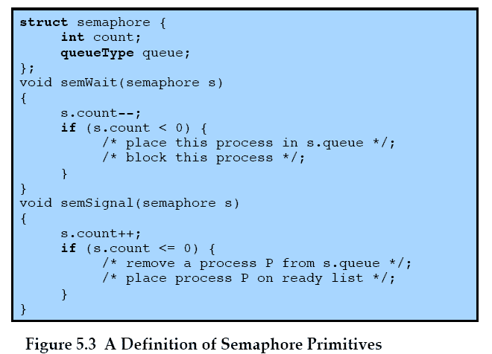
Semaphore Primitives (Additional slides for better understanding)
Notes:
An example of a semaphore

Slide 24
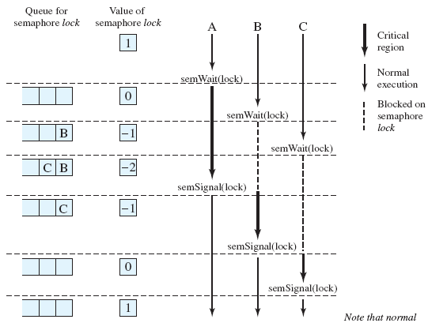
Semaphore Primitives (Additional slides for better understanding)
Notes:
Figure 5.7, shows a possible sequence for three processes using the mutual exclusion discipline of Figure 5.6.
Three processes (A,B, C) access a shared resource protected by the semaphore lock.
Process-A executes semWait(lock);
because the semaphore has a value of 1 at the time of the semWait operation, A can immediately enter its critical section and the semaphore takes on the value 0.
While A is in its critical section, both B and C perform a semWait operation and are blocked pending the availability of the semaphore.
When A exits its critical section and performs semSignal(lock), B, which was the first process in the queue, can now enter its critical section.

Slide 25
Deadlock and Starvation
Deadlock – two or more processes are waiting indefinitely for an event that can be caused by only one of the waiting processes
Let S and Q be two semaphores initialized to 1
P₀ P₁
wait (S); wait (Q);
wait (Q); wait (S);
. .
. .
. .
signal (S); signal (Q);
signal (Q); signal (S);
Starvation – indefinite blocking
A process may never be removed from the semaphore queue in which it is suspended.
For example, when using LIFO queue for keeping the blocked processes.

Slide 26
Deadlock and Starvation
Priority Inversion –
Scheduling problem when lower-priority process holds a lock needed by higher-priority process
Solved via priority-inheritance protocol
Details from Book – Included in Exam Syllabus

